Slide 1
Knowledge-based Graph Document Modeling
Date: 2014/05/06
Author: Michael Schuhmacher,
Simon Paolo Ponzetto
Source: WSDM’14
Advisor: Jia-ling Koh
Speaker: Chen-Yu Huang

Slide 2
Outline
Introduction
Modeling document content
Graph-based entity ranking
Computing document similarity
Experiments
Conclusion

Slide 3
Introduction
Recent years have seen great deal of work on developing wide-coverage semantic technologies and method embedding semantic models.
Semantic information and knowledge-rich approaches can be used effectively for IR and NLP tasks.

Slide 4
Introduction
Not exploit the relational knowledge and network structure encoded within wide-coverage knowledge bases.
Propose a graph-based semantic model for representing document content, relies on the use of a semantic network.

Slide 5
Outline
Introduction
Modeling document content
Graph-based entity ranking
Computing document similarity
Experiments
Conclusion

Slide 6
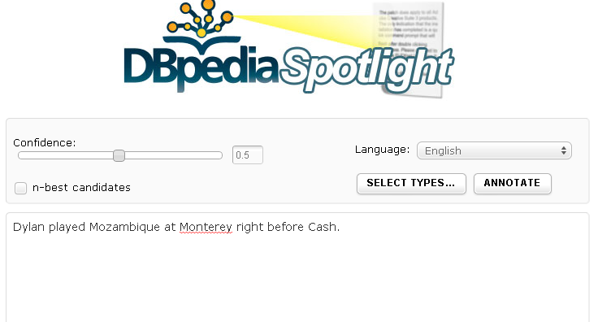
DBpedia
A community effort to extract structured information from Wikipedia.
Provide a wide-coverage knowledge base with many explicit semantic relations between entities.
RDF triple in DBpedia : subject, predicate and object

Slide 7
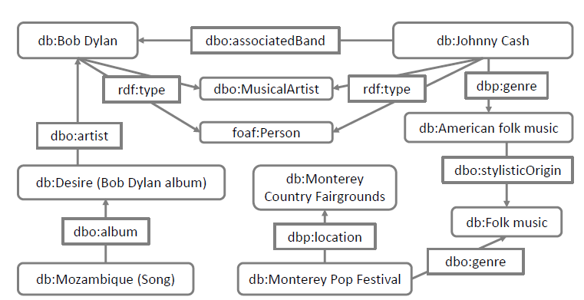
Semantic graph construction
Create a labeled directed graph G = (V, E)
Nodes V : all input concepts C
connect: semantic relations R
Edges E : (v, r, v)
Expand : perform a depth-first search along the
DBpedia graph and add all outgoing relations r
Maximal length L = 2
Dylan played Mozambique at
Monterey right before Cash.

Slide 8
Semantic relation weighting
Weights are meant to capture the degree of associativity between concepts in the graph.
Assumption that specificity is a good proxy for relevance.
Information Content(IC)
P(ωPred) : the probability that the random variable XPred describing the type of edge
EX :
rdf:type
dbo:associatedBand

Slide 9
Semantic relation weighting
Joint Information Content(joint IC)
EX:
Combined Information Content(combIC)
EX:
foef:Person
dbo:MusicalArtist
db:American folk music

Slide 10
Semantic relation weighting
Information Content and Pointwise Mutual Information (IC+PMI)
PMI : measure the mutual dependence between the two
variable

Slide 11
Outline
Introduction
Modeling document content
Graph-based entity ranking
Computing document similarity
Experiments
Conclusion

Slide 12
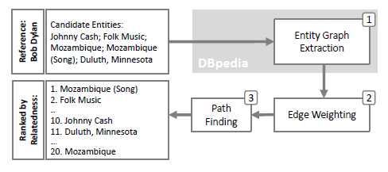
Graph-based entity ranking
Three main steps:
Build a semantic graph
Weight graph edges by edge cost
W(e) : weighting function
Wmax : globally highest possible weight in DBpedia graph

Slide 13
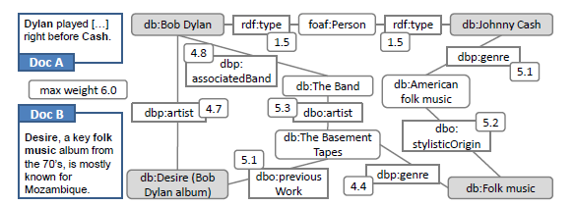
Graph-based entity ranking
Compute semantic distances between entity pairs
EX:
cp1 = 6.0-4.7=1.3
cp2=(6.0-4.8)+(6.0-5.3)
+(6.0-5.1)=2.8
distance = 1.3
db: Bob Dylan
db: Desire(Bob Dylan album)
Wmax=6.0

Slide 14
Outline
Introduction
Modeling document content
Graph-based entity ranking
Computing document similarity
Experiments
Conclusion

Slide 15
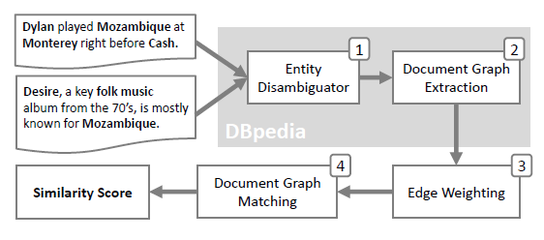
Computing document similarity

Slide 16
Computing document similarity
Opt for an application of Graph Edit Distance(GED) to be able to effectively quantify degrees of similarity.
Define the distance between two graph in terms of the minimum cost of edit operation needed to transform one graph to the other.
Nodes in the DBpedia graph is unique, not need to account for label mismatch between concepts.
Define node modifications on the basis of the underlying edge structure.

Slide 17
Computing document similarity
The modification cost between two nodes is defined as the sum of the edge costs along their connecting graph.
Adapt an approximation method based on bipartite graph matching for finding the minimal edit cost.
GED is now a bipartite graph matching problem that solve this minimization problem using the Hungarian method.

Slide 18
Computing document similarity
v1
v2
EX: Doc A : db:Bob_Dylan, db:Johnny_Cash
Doc B : db:Desire_(Bob Dylan album), db: folk music
(v1, v3)(v1, v4)(v2, v3)(v2, v4)
c(v1,v3) =1.3 c(v1,v4)=3.5 c(v2,v3)=4.2 c(v2,v4)=1.7
Distance(vi,vj) = c(vi,vj)
distance
= (1.3+1.7) / 2
v3
v4
Hungarian Algorithm

Slide 19
Outline
Introduction
Modeling document content
Graph-based entity ranking
Computing document similarity
Experiments
Conclusion

Slide 20
Experiments---entity ranking
dataset
21 different reference entities

Slide 21
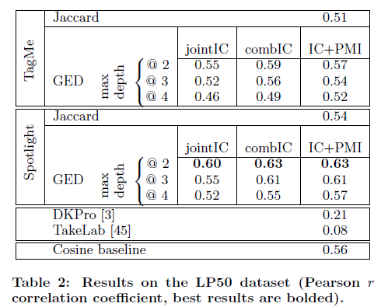
Experiments---similarity
Dataset
50 news articles
Linked system
Dbpedia
TagMe

Slide 22
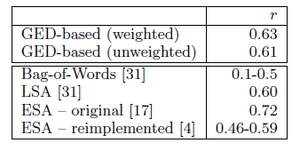
Experiments---similarity
Dataset
50 news articles

Slide 23
Outline
Introduction
Modeling document content
Graph-based entity ranking
Computing document similarity
Experiments
Conclusion

Slide 24
Conclusion
The first proposal to exploit a Web-scale ontology to provide structured representations of a document content and computing semantic distances in a knowledge-rich fashion.
Future work plan to develop method to jointly perform entity disambiguation and compute semantic similarity.

